Slide 1

Houston Peace & Justice Center
Board Orientation
& Planning Workshop
June 2026

Slide 2
Agenda
Objectives - Why this Workshop?
Introductions - Getting to Know Each Other
Getting to Know HPJC
Review HPJC's Strategic Plan

Slide 3
Objectives - Why this Workshop?
Get to know each other so we can work together better and support one another
Learn more about HPJC so we can make HPJC more effective
Review HPJC's goals, objectives, and strategies and begin considering any needed updates, to rejuvenate HPJC and help us reach our goals!

Slide 4
Introductions,
Getting to Know Each Other
Introduce yourself
Summarize your background relevant to HPJC
Skills & experience – activism & professional
Interest areas
One thing you'd like to help HPJC do better

Slide 5
Getting to Know HPJC
HPJC Mission
HPJC Structure – Board, Executive Committee, other committees
Working Groups
Primary Activities
HPJC Web Site, Email Lists, and Social Media
Bylaws & Policies
Schedule of Regular Activities, including Administrative

Slide 6
HPJC Mission
HPJC serves as an action center for peace and justice efforts.
We provide peace education, activism training, and collaborative resources for individuals, families, and organizations throughout the Greater Houston area to build a just, non-violent community.
Where to find the Mission: In our Bylaws, plus a summary is at the top of each page on hpjc.org

Slide 7
HPJC Working Groups
Economic Justice
Environmental Justice
Foreign and Military Policy
Human Rights and Criminal Justice
Peace Education

Slide 8
Primary Activities
Communication via HPJC's Web Site and Email Calendar of Progressive Events Newsletter
Networking and Publicizing other Organizations' Activities & Events
Peace Camp & Peace Club
Annual Peacemaker Awards Ceremony
Conferences, Workshops - often as a co-sponsor

Slide 9
Web Site -- hpjc.org
What's there, including what's not so obvious:
Calendar of Events
Working Groups & Peace Camp Information
Board Resources & more About HPJC
HPJC News, Announcements, Public Statements
National & International News Updates, & more!

Slide 10
Internal HPJC Communications
We have several e-mail lists for internal communications:
Announcements (FYI) List: fyi@hpjc.org
Board List: board@hpjc.org (subset of the FYI list)
Executive Committee List: ec@hpjc.org (subset of the Board list)
Plus some more lists for planning of specific activities:
  Peace Camp List: peacecamp@hpjc.org
  Awards Dinner Planning List: dinner@hpjc.org
  Conference planning List: conference@hpjc.org
  General Planning List: planning@hpjc.org

Slide 11
HPJC
Board
Individual
Members
HPJC
Executive Com
Organizational Members
Organizational Members
Representatives of the Individual Members
Representatives of the Individual Members

Slide 12
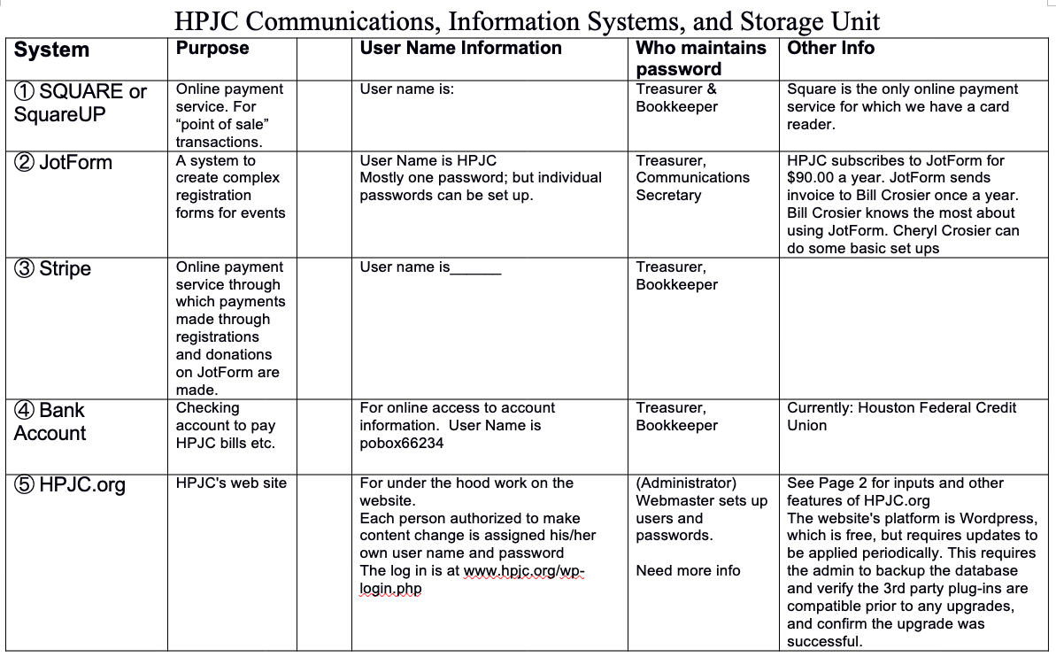

Slide 13
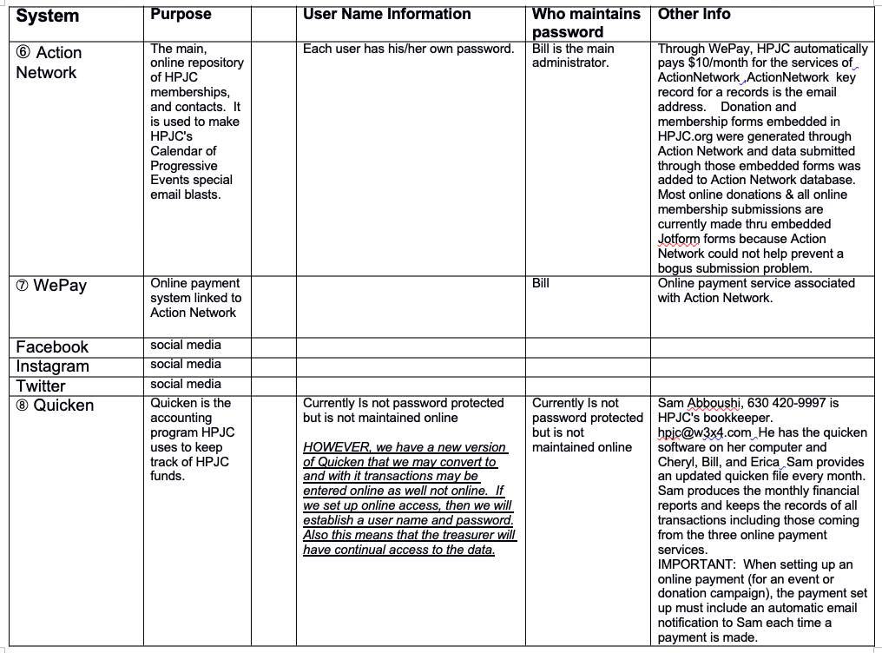

Slide 14
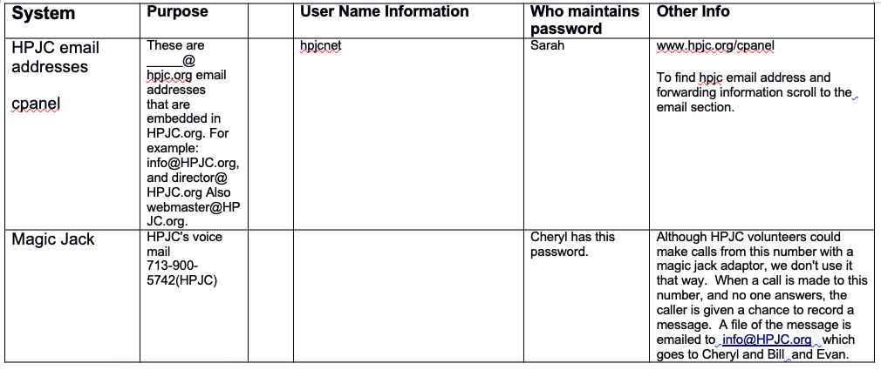

Slide 15
HPJC Bylaws
Link to the Bylaws is on Board Resources page. Sections include:
Mission, Corporate Charter and Offices, Tax Status
Membership and Dues
Board of Directors
Officers and Executive Committee
Advisory Board
Corporate Records and Reporting
Adoption and Amendment of Bylaws

Slide 16
Policies Adopted by Board, part 1
Link to the policies is on Board Resources page
Policy 1 MEMBERSHIP DUES
Policy 2 REQUESTS FOR FUNDING
Policy 3 PUBLIC STATEMENTS
Policy 4 ANNUAL RETREATS
Policy 5 DUTIES OF THE COMMUNICATIONS SECRETARY
Policy 6 HPJC EVENT ENDORSEMENT/COSPONSORSHIP POLICY
Policy 7 HPJC CONFERENCES
Policy 8 GUIDELINES REGARDING TIME LIMITS FOR DISCUSSIONS

Slide 17
Policies Adopted by Board, part 2
Policy 9 POLICY REGARDING WAIVER OF DUES
Policy 10 POLICY FOR SELECTION OF HOUSTON-BASED HONOREES FOR HPJC AWARDS BANQUET
Policy 11 GUIDELINES FOR ELECTIONS COMMITTEE
Policy 12 ACCEPTING GRANTS FOR MEMBER ORGANIZATIONS
Policy 13 PLANNING AND BUDGETING
Policy 14 TWICE-MONTHLY E-MAIL CALENDAR: GUIDELINES FOR INCLUSION OF EVENTS
Policy 15 NUMBER OF INDIVIDUAL MEMBERS ON BOARD
Policy 16 SOLICITING & ACCEPTING GRANTS FOR HPJC
Policy 17 TWO AUTHORIZATIONS - HPJC CHECKS & EFT TRANSACTIONS
Issue Positions that HPJC has taken are also in the Policies document.

Slide 18
Finances
Software tools we use
Where money comes from
Where money goes

Slide 19
Receipt/Disbursement of monies, data associated with each transaction, and miscellaneous data.
This step is tedious and not done consistently.
HPJC.org online forms
for
calendar subscriptions, volunteers
Monies
Data
Square accumulated monies transfer directly to checking account when transfer is initiated by Treasurer.
Square Card Reader
Point of Sale Transactions; not online
SQUARE automatically sends an email which includes amounts and associated data to the treasurer and bookkeeper when a payment is made through Square.
Data transferred online to Action network
Online transfer
Stripe automatically deposits accumulated monies directly to checking account on a periodic basis.
JotForm automatically sends an email which includes amounts and associated data to the treasurer and bookkeeper when a registration is made through JotForm.
Action
Network
Online Contacts Database and email service. Records can show detailed contact history. Can use it to make online forms and generate various spreadsheet reports about contacts.
JotForm
Registrations
(Stripe)
Data transferred MANUALLY
Name, address, phone number, email address, transaction amount (if applicable), purpose, notes, tags etc
Treasurer (or someone acting for treasurer) deposits Checks & Cash in the checking account.
Treasurer uses Quicken Online to enter information about Deposits, Checks & Cash amounts, payer information, and budget category to bookkeeper for each deposit.
Manual transfer
Checks, ACH & Cash
Credit Union Checking Account
Bookkeeper manually downloads credit union transactions into Quicken
Quicken
Quicken Reports
Bookkeeper maintains a record of all transactions using Quicken. The bookkeeper maintains these records on HIS computer.From Quicken data bookkeeper generates reports
Monthly Financials
Monthly copy Quicken account file for Treasurers’ use
Data for Donation Statements
Misc Reports for Treasurer
Data for 990 Tax Filings
Data for 1099NECs

Slide 20
Schedule of Regular Activities
including Administrative
All Executive Committee members should be aware of the many behind-the-scenes activities needed.
The schedule/list of regular activities is in a table – link is on the Board Resources web page

Slide 21
Part 2
Review HPJC's Strategic Plan
Why do we care about our Strategic Plan?
It summarizes our vision for the future
It's a roadmap to get there
It lists goals, objectives, and strategies to reach them
It's how we plan to implement the HPJC Mission
and It's time to review and update it - so think about this

Slide 22
HPJC Strategic Plan -- 2014-2019
The plan contains these sections:
Our Long Range Vision for Greater Houston
Mission of HPJC
Our Vision of Houston in 25 Years
The Challenges to Realizing Our Vision
Our vision of HPJC in 25 years
Feasible Five Year Goals for HPJC as an Organization
HPJC Working Groups – Suggested Five Year Goals

Slide 23
Our Long Range Vision for Greater Houston - rev. 2014
Our vision for the Houston metropolitan area is a just and nonviolent community where the inherent dignity of all people is recognized. The best touchstone of such a community is how it takes care of its most vulnerable members, particularly its children. All residents should have the resources and support they need to realize their potential and exercise their talents, free from grinding poverty, baseless discrimination, exploitation and the threat of violence.
We also envision Greater Houston as a community that recognizes its interdependence with all of creation and is, therefore, committed to sustainable development, environmental protection and care for the entire web of life.
Furthermore, we see Greater Houston as a city that supports the use of diplomacy as a means of solving local, national, and international problems, and is a leading force in moving the nation and the world toward becoming a more just and nonviolent place.

Slide 24
Mission of HPJC – from 2014 Strategic Plan
We work to promote Peace, Justice and Environmental Protection by providing resources to member organizations and individuals in Greater Houston.
We join with other organizations in making public statements in support of our mutual efforts to promote these goals.
We undertake projects to support ourselves and to spread information about Peace, Justice and the Environment within the Greater Houston community.

Slide 25
Our Vision of Houston in 25 Years
If the reality for people in Greater Houston were to change in the following ways by 2038, our society will have taken great strides toward becoming the just nonviolent community to which we aspire.
Peace
Justice
Environment
While we review these (briefly), consider how HPJC can help realize this vision - we'll discuss this later today

Slide 26
Vision for Houston - Peace
Institutions bearing the most responsibility for forming and informing the public conscience are emphasizing peace and justice.
Grade and high school curriculum emphasize the importance of civic life and citizenship plus environmental stewardship, and specifically promote non-violent conflict resolution, basic human and civil rights, and conservation.
Military training has been removed from schools and colleges.
Children learn about failures as well as positive aspects of US foreign policy, especially our reliance on use of the military.
People are quick to question our government when there are temptations to attack or invade another country in order to protect economic interests.
Religious leaders are proclaiming with courage and intelligence the foundational teachings of their faiths in these areas.
It is commonplace for media to question the illegitimate exercise of power, especially military and economic power.

Slide 27
Vision for Houston - Justice - part 1
More citizens, especially low-income citizens and people of color, are voting, and campaign finance reform and increased transparency have reduced the ability of large donors to determine the outcomes
Adequate resources and support for health care, education, skills training, child care, neighborhood empowerment, environmental restoration, and other programs of social uplift.
Greater Houston has moved beyond establishing a minimum living wag, towards the broader goal of a life of meaning and self-support for all citizens.
There is universal access to health care, including mental health services. Unwanted pregnancies have been reduced through education of the public and family planning.

Slide 28
Vision for Houston - Justice - part 2
People migrating to the US to contribute to our society and for a better life for their families are treated with fairness and respect for their human rights and dignity.
Houston is a city accepting of people who desire to define what they see as a meaningful life through efforts like worker-owned cooperatives.
Our criminal justice system has changed to a system of restorative justice. Providing adequate social services has helped to reduce crime. Citizens accused of crimes have access to high quality legal assistance regardless of their economic status. The death penalty has been abolished. All remaining justice institutions now require education on nonviolent conflict resolution skills for law enforcement, prison guards and inmates, and comprehensive rehabilitation and reintegration training.

Slide 29
Vision for Houston - Environment - part 1
Heightened understanding of our interdependence with our natural environment: We understand our joint responsibility to preserve and restore our environment; maximizing short term interests should rarely be as important as maintaining a healthy planet for those of the future; we work to conserve and renew resources for future generations; we understand the need to reduce our energy footprint; and we all understand that systems that give 80% of world resources to 20% of the earth’s population are unjust, and the main causes of the waste products that presently threaten all future life.
Houstonians are well informed about food choices and there is a great dietary reliance on grains, vegetables, and fruits produced without non-renewable products or genetic modification. The people of Greater Houston grow much of their food themselves or buy it directly from area growers. Air, water, soil, or food pollution is seen as intolerable criminal behavior, and the importance of forests, prairies, wetlands and high carbon soils is widely appreciated.

Slide 30
Vision for Houston - Environment - part 2
People in the US use more resources than people in any other part of the planet, so many of us have limited the size of our families to one or two children.
Houstonians conserve energy in a variety of areas, including emphasis on recycling and public transport, and designing their activities to get the most functionality out of investments in energy, materials and labor. Tax policy and building codes are used to conserve energy, water, food and other resources. There is widespread recognition that low-density growth in the suburbs displaces agriculture and puts additional stresses on the environment. People avoid long commutes in single passenger vehicles. Our public transportation system has been greatly expanded and most people use public transit on a regular basis.
Houston and the surrounding region have helped reduce of greenhouse gas emissions and increase re-absorption of CO2. Industrial and residential users conserve energy; have converted to the use of solar and wind to produce power, and use fewer, more durable, renewable, multi-functional, and group-owned possessions.

Slide 31
The Challenges to Realizing Our Vision
The people of Greater Houston do not recognize their interdependence with the planet and all of its people.
There is a reluctance to acknowledge, or rectify, the injustices in our city, state, nation, and world.
The response is often to lay blame on others rather than sharing responsibility for their causes and cures.
The dominant culture generally does not regard poor people, people of color, recent immigrants, gays and lesbians, and people of certain religious faiths and nationalities as brothers and sisters, but rather as the cause of society’s problems.
Seeing some groups as 'others', ather than our brothers and sisters who are victims, encourages people to see them as unworthy, and makes it easier to blame them. This then leads to hostility, which easily breaks out into violence, both individual and collective.

Slide 32
Recognizing the Manifestations of an Unjust Society
These problems are additional challenges we face.
(Read details in the Strategic Plan)
​Problem: Indifference to the Persistence of Poverty
Problem: Pervasiveness of Violence
Problem: An Ethic Of Exploitation
Problem: The Role of Government

Slide 33
Our vision of HPJC in 25 years
(see Strategic Plan)
What do you like and not like about the vision of HPJC? (Note - this is a different section than the vision of Houston in 25 years)
What would you like to add? (especially things that could be relevant to HPJC planning)

Slide 34
Goals - Why Do We Need Them?
Why and How do Goals help us to:
Focus our time, energies, and limited funds
Recruit volunteers
Attract donors and grants
Be more successful
Realize our vision and fulfill our mission

Slide 35
Feasible Five Year Goals for HPJC
as an Organization (from 2014)
Future of HPJC Committee
Membership goals
Communication goals
Organizational Effectiveness goals
Details are on the following slides (in no particular order).
Think about what specific goals we should change,
& strategies to reach our goals and achieve our vision.

Slide 36
Possible 5-year Goal:
Future of HPJC Committee
1. Full time Executive Director
2. Physical space, fully staffed during most business hours
3. Increase annual income to $75,000 (from $23,000)
4. Establish fundraising mechanisms in addition to the dinner

Slide 37
Possible 5-year Membership goals
5. Grow membership from 100 to 2000 (hire membership coordinator; make videos; PSA's )
6. Increase diversity in ethnicity, age, education, economic background, etc. of our membership and leadership
7. Recruit ethnically diverse organizations as members
8. Institutionalize amicable relations between members and between member organizations

Slide 38
Possible 5-year Communication goals
9. Professional quality HPJC newsletter and other means of communicating with our membership
10. Full utilization of website features and tools
11. Utilize KPFT and other media to promote events and projects for HPJC and member organizations
12. Make presentations to City Council on peace, justice and environmental issues

Slide 39
Possible 5-year
Organizational Effectiveness goals
13. Provide regularly scheduled skill share sessions for members and others
14. HPJC volunteer coordinator and volunteer plan
15. Our five working groups and organizational committees are operating and adequately resourced to address their identified goals.

Slide 40
HPJC Working Groups –
Suggested Five Year Goals (from 2014)
Foreign and Military Policy
Environmental Justice
Human Rights/Criminal Justice
Economic Justice
Peace Education for Families & Children
See the Strategic Plan for suggested goals from each of our five working groups, and consider changes, plus strategies to achieve them.

Slide 41
What's Next - for 2022?
Considering HPJC's Mission, and the Vision and Goals from our last Strategic Plan, let's brainstorm:
What do we want to do this year to make a difference in our community? Time to plan!
What Activities - old, new, changed?
How to Improve Organizational Effectiveness?
Update Strategic Plan?

